Slide 1
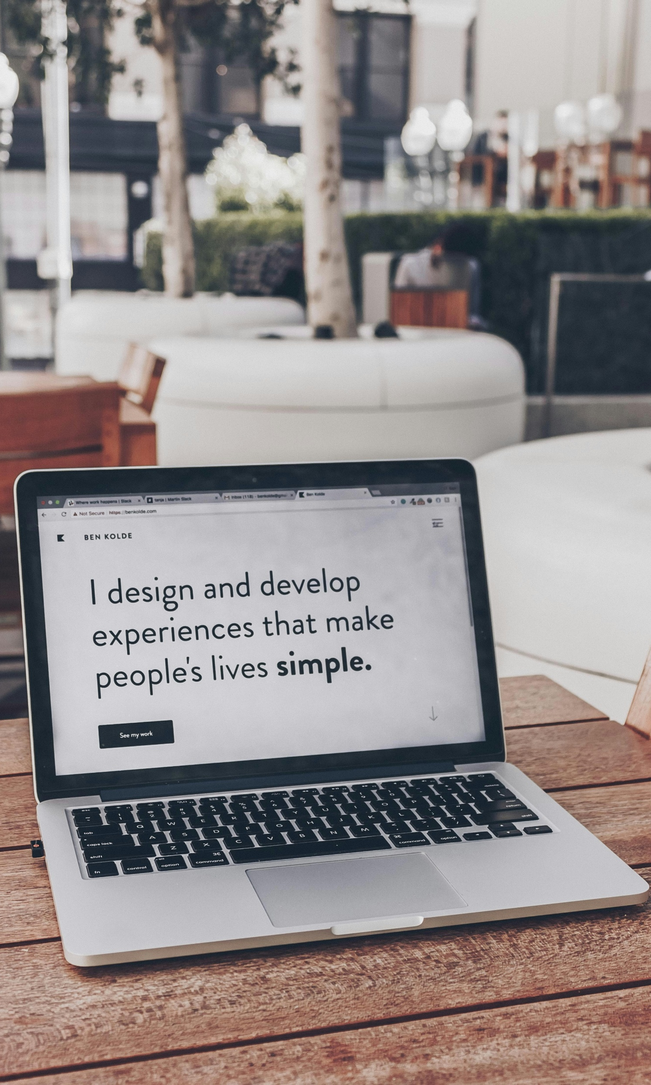


Building Modern Web Apps with Accessibility in Mind
Easy Ways to Make your Application Works for Everyone
Nerds Room 2025

Slide 2

What We’ll Cover
We’ll explore what accessibility really means, why it matters, and how we can use simple practice (and a little AI help) to make our apps usable by everyone.
01.
What is Accessibility?
02.
Why it Matters
03.
Common Pitfalls
04.
Tools & AI Helpers
05.
Practical Examples & Quick Demo
06.
Tips & Resources
07.
Let’s Test Our Awareness!
08.
Thank You!
Notes:
Common mistakes developer makes

Slide 3

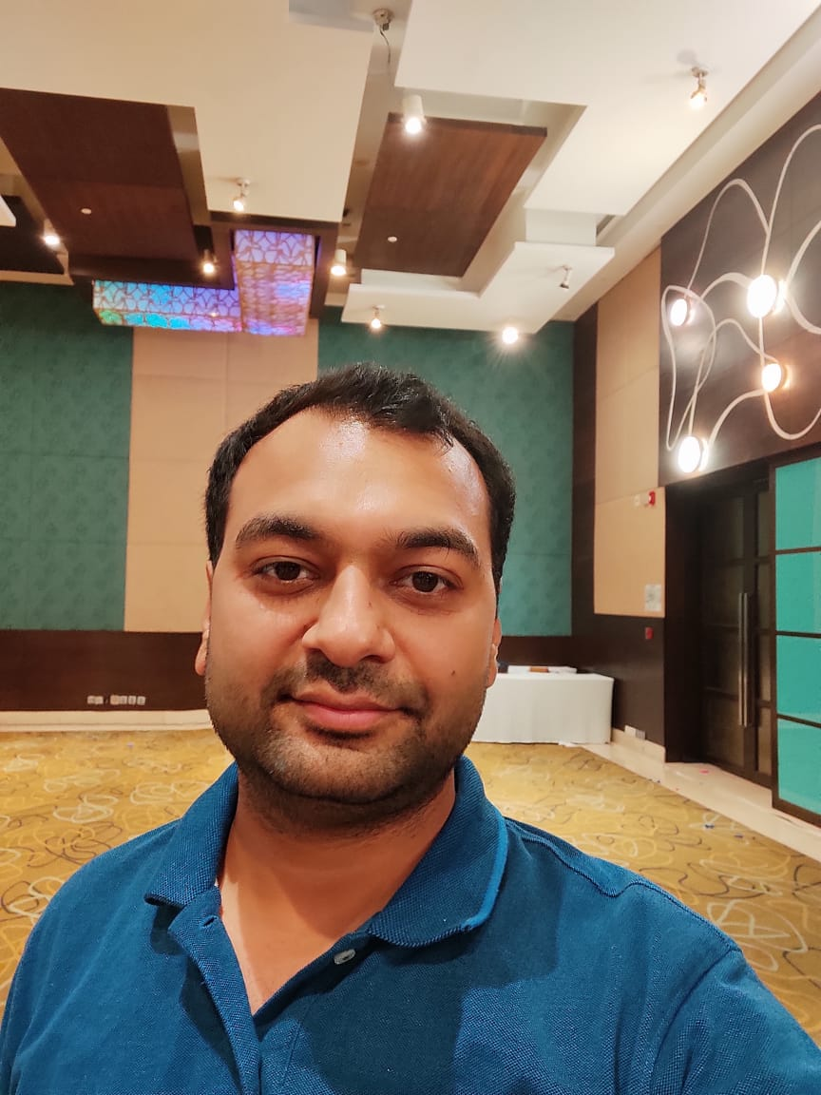




About Me…
Experience
13+ years in web development, BFSI & enterprise apps (Wells Fargo Bank, Deutsche Bank, Citibank)
Angular Expert Certified, 10+ years with Angular
Currently building low-code/no-code UI frameworks at SBS
Focused on modern UI, accessibility, and quality
👋Hi, I am
Himanshu Goel
Architect @ SBS, Noida
Community & Interests
Attending tech meetups and conferences
Blogger & open-source contributor
Love to build side projects, travel, and explore new food. 😋
https://x.com/himanshugoelmca
https://github.com/HimanshuGoel/
https://www.linkedin.com/in/himanshu-goel-mca/

Slide 4

Before We Start…
Everything I’m sharing today reflects my own experience and learnings — not the official view of my employer or Nerds Room.
This session is purely for learning and knowledge-sharing.
Some tools or frameworks mentioned may have alternatives — feel free to explore what works best for you!
Also, any logos or screenshots are used for illustration only and belong to their respective owners.

Slide 5

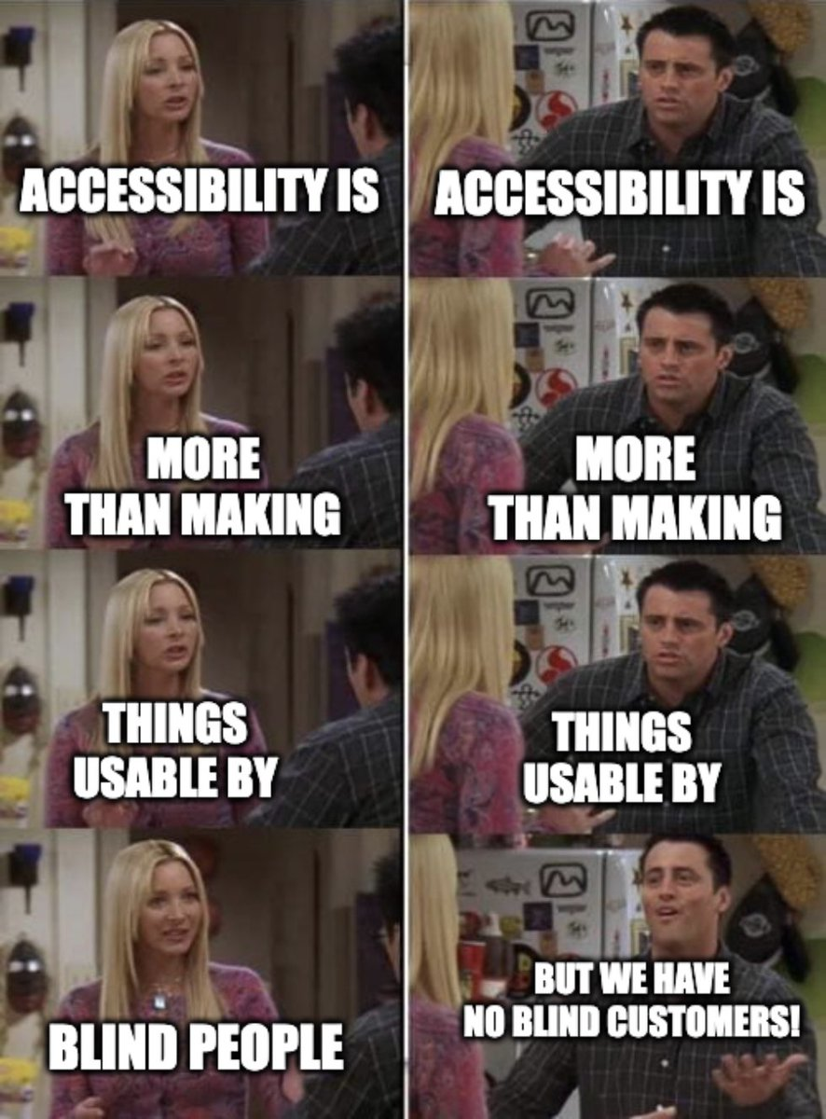
(abbreviated as a11y)
What is Accessibility?

Slide 6
Quick Quiz!

Slide 7

Survival Scrolling
It’s 1 AM. Lights are off. Brightness is at 0.You’re scrolling Instagram / LinkedIn.
Which accessibility feature is helping you?
B. Dark Mode & High Contrast
A. Captions
C. Voice Control
D. Auto-play

Slide 8
Survival Scrolling
It’s 1 AM. Lights are off. Brightness is at 0.You’re scrolling Instagram / LinkedIn.
Which accessibility feature is helping you?
B. Dark Mode & High Contrast
Note: This is the exact same feature used by people with light sensitivity or low vision. You just use it at 1 AM.

Slide 9
Ordering food at 2 AM in the dark
You’re tired. Half asleep. Phone on lowest brightness. You still manage to order biryani successfully.
Which accessibility feature is helping you?
A. Large touch targets
B. Simple layout
C. Screen reader labels
D. Dark mode

Slide 10
Ordering food at 2 AM in the dark
You’re tired. Half asleep. Phone on lowest brightness. You still manage to order biryani successfully.
Which accessibility feature is helping you?
All of them
Note: You are temporarily: low vision + low focus + low motor control. That’s 3 disabilities at once..

Slide 11
One-hand mode
You’re holding: a coffee, a bag or a baby. And still using your phone.
Which accessibility feature is helping you?
B. Large, well-spaced buttons
A. Keyboard Shortcuts
C. Background Music
D. Auto logout

Slide 12
One-hand mode
You’re holding: a coffee, a bag or a baby. And still using your phone.
Which accessibility feature is helping you?
B. Large, well-spaced buttons
Note: This is motor accessibility. Same for someone with only one usable hand.

Slide 13
Office / Classroom stealth mode
You’re in a boring meeting or lecture but watching a tutorial on mute.
Which accessibility feature is helping you?
B. Ads
A. Autoplay
C. Closed Captions (Subtitles)
D. Animations

Slide 14
Office / Classroom stealth mode
You’re in a boring meeting or lecture but watching a tutorial on mute.
Which accessibility feature is helping you?
C. Closed Captions (Subtitles)
Note: You’re actually relying on is an accessibility feature designed for people who can’t hear the audio at all.

Slide 15
One earphone gaming
You’re gaming / watching a video. One earphone is out because your mom is calling your name.
Which accessibility feature is helping you?
B. Faster Wi-Fi
A. Bigger Buttons
C. Subtitles / Visual Sound Cues
D. Dark Mode

Slide 16
One earphone gaming
You’re gaming / watching a video. One earphone is out because your mom is calling your name.
Which accessibility feature is helping you?
C. Subtitles / Visual Sound Cues
Note: For you it’s a choice. For some people it’s permanent. Same feature.

Slide 17
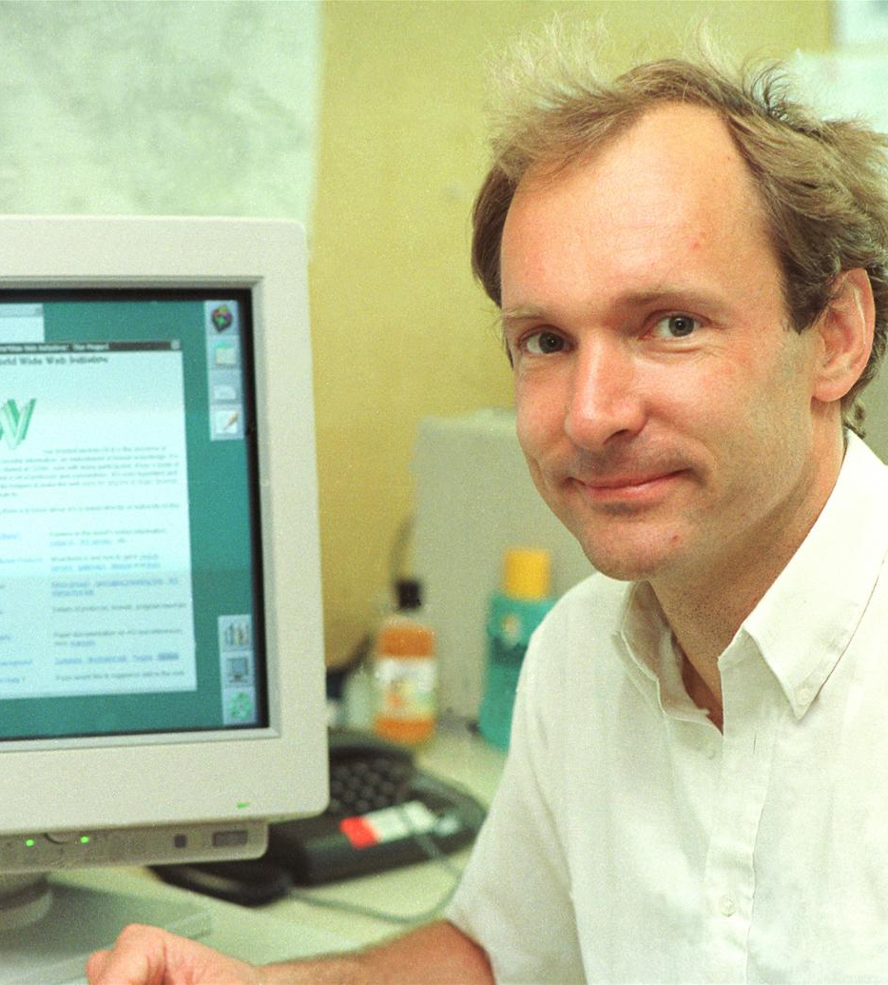

”
The power of the Web is in its universality. Accessibility for everyone, regardless of disability, is an essential aspect.
Tim Berners-Lee → Web Developer

Slide 18

To Put It Simply...
Accessibility means making apps that work for everyone, including people with different disabilities.

Slide 19
To Put It Simply...
Accessibility means making apps that work for everyone, including people with different disabilities.
Vision
Example: A blind user browsing your app with a screen reader.

Slide 20
To Put It Simply...
Accessibility means making apps that work for everyone, including people with different disabilities.
Vision
Hearing
Example: A blind user browsing your app with a screen reader.
Example: A user who relies on captions to watch your tutorial video.

Slide 21
To Put It Simply...
Accessibility means making apps that work for everyone, including people with different disabilities.
Vision
Hearing
Example: A blind user browsing your app with a screen reader.
Example: A user who relies on captions to watch your tutorial video.
Understanding
Example: A person with learning difficulty needing clear and simple content.

Slide 22
To Put It Simply...
Accessibility means making apps that work for everyone, including people with different disabilities.
Vision
Hearing
Example: A blind user browsing your app with a screen reader.
Example: A user who relies on captions to watch your tutorial video
Understanding
Mobility
Example: A person with learning difficulty needing clear and simple content.
Example: A user who can't use a mouse and uses only a keyboard.

Slide 23
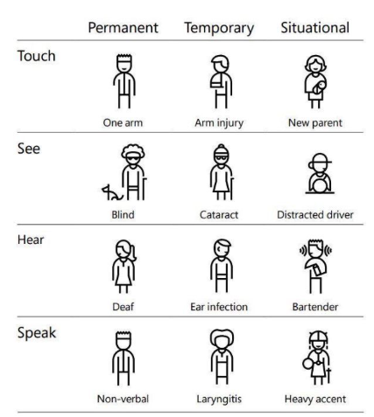
Accessibility also helps people in a variety of situations – not just with long-term disabilities.
Types of Accessibility Needs
Permanent
A person born blind or with a missing limb
Temporary
A broken arm, eye surgery, or ear infection
Situational
Using a phone in bright sunlight
Watching a video in a noisy train
Holding a baby with one hand

Slide 24
Why Accessibility Matters

Slide 25

4 Simple Reasons to Care About Accessibility
Reason #1
Digital Equality
The web is a public space — everyone deserves full access.
It’s not just good tech, it’s digital justice.

Slide 26
4 Simple Reasons to Care About Accessibility
Reason #1
Reason #2
Legal Requirement
Digital Equality
Required by laws like Section 508 in US, European Accessibility Act 2025 (EAA), and similar laws exists worldwide.
The web is a public space — everyone deserves full access.
It’s not just good tech, it’s digital justice.
Based on global standards like WCAG (Web Content Accessibility Guidelines).
Avoids legal risks and promotes ethical responsibility.

Slide 27
4 Simple Reasons to Care About Accessibility
Reason #1
Reason #2
Legal Requirement
Digital Equality
Required by laws like Section 508 in US, European Accessibility Act 2025 (EAA), and similar laws exists worldwide.
The web is a public space — everyone deserves full access.
It’s not just good tech, it’s digital justice.
Based on global standards like WCAG (Web Content Accessibility Guidelines).
Avoids legal risks and promotes ethical responsibility.
Reason #3
Better Business Outcomes
More users = more reach = more impact.
Improves SEO through semantic HTML and better content structure.
Competitive advantage.

Slide 28

4 Simple Reasons to Care About Accessibility
Reason #1
Reason #2
Legal Requirement
Digital Equality
Required by laws like Section 508 in US, European Accessibility Act 2025 (EAA), and similar laws exists worldwide.
The web is a public space — everyone deserves full access.
It’s not just good tech, it’s digital justice.
Based on global standards like WCAG (Web Content Accessibility Guidelines).
Avoids legal risks and promotes ethical responsibility.
Reason #3
Reason #4
Better Business Outcomes
Promotes Good Design
More users = more reach = more impact.
Many “accessibility features” became everyday features (think dark mode, captions, skip links).
Improves SEO through semantic HTML and better content structure.
It forces you to design with intention, not assumption.
Competitive advantage.

Slide 29

Accessibility in Numbers
97.4%
Websites fail at least one WCAG 2.1 AA requirement
71%
Users leave if a app isn’t accessible – that’s wasted sprint effort and lost customer value.
5,500
Accessibility lawsuits filed in the U.S. in 2023 alone
$8T
Combined global disposable income of people with disabilities and their families
86%
Accessibility issues are detectable through automation testing –
but still ignored. It can be part of Definition of Done.
Data sourced from UserWay, WebAIM, 3Play Media, Accessibility Works, Global Business Coalition for Education, and The Valuable 500

Slide 30

Most Common Accessibility Issues 96% of issues fall into these 6 categories
Hard-to-read text (low-contrast colors)
79.1%
Images without descriptions (no alt text)
55.5%
Forms without instructions (missing labels)
48.2%
Links that go nowhere (empty links)
45.4%
General Misconception…
“We are making the web accessible for disabled people — actually, we are making the web accessible for our future selves.”
Buttons with no meaning (empty buttons)
29.6%
Pages without a set language (screen readers can’t read properly)
15.8%

Slide 31
Common Pitfalls

Slide 32

Missing Semantic HTML
Accessibility Seen as Later Work
Not in
Definition of Done
Dynamic Content
not Explained
Small misses that quietly create big barriers!
Inadequate Colour Contrast
Rely Only
on Visuals
No Keyboard Testing
Auto-Playing Content
Unclear Error Messages

Slide 33
Available Tools and AI Helpers

Slide 34


Tools That Make Accessibility Easier
For Developers
For Leadership
Framework Support
Lighthouse Reports & Accessibility Insights
UI Components & ARIA Helpers
Browser Tools (Wave, Web Toolbar)
Built-in Form Validators
Checklists & toolkits (WCAG, Inclusive Design Toolkit)
Axe-core & Cypress-axe
Collaboration & feedback (UserZoom)
Screen Readers (NVDA, VoiceOver)

Slide 35

AI Helpers
Making accessibility easier, faster, and smarter for your team.
Sign Language to Voice/Chat
Google’s Project Relate, MS AI for Accessibility

Slide 36

AI Helpers
Making accessibility easier, faster, and smarter for your team.
Sign Language to Voice/Chat
Personal Reading Helper
Google’s Project Relate, MS AI for Accessibility
Microsoft Immersive Reader, Read&Write, GPT paraphrase prompts

Slide 37

AI Helpers
Making accessibility easier, faster, and smarter for your team.
Sign Language to Voice/Chat
Personal Reading Helper
Auto Audit + Fix Suggestions
Google’s Project Relate, MS AI for Accessibility
Microsoft Immersive Reader, Read&Write, GPT paraphrase prompts
axe-core + GPT workflows, Evinced, Accessibility Insights

Slide 38

AI Helpers
Making accessibility easier, faster, and smarter for your team.
Sign Language to Voice/Chat
Personal Reading Helper
Auto Audit + Fix Suggestions
Smart Screen Readers / Scene Description
Google’s Project Relate, MS AI for Accessibility
Microsoft Immersive Reader, Read&Write, GPT paraphrase prompts
axe-core + GPT workflows, Evinced, Accessibility Insights
Microsoft Seeing AI, Google Lookout

Slide 39

AI Helpers
Making accessibility easier, faster, and smarter for your team.
Voice Control Instead of Mouse or Keyboard
Google Assistant, Alexa for Apps, iOS Voice Control

Slide 40

AI Helpers
Making accessibility easier, faster, and smarter for your team.
Voice Control Instead of Mouse or Keyboard
Smart Captions & Audio Understanding
Google Assistant, Alexa for Apps, iOS Voice Control
Not just words people say, but also sounds or moods
Google auto-captions and Sound Notifications

Slide 41

AI Helpers
Making accessibility easier, faster, and smarter for your team.
Voice Control Instead of Mouse or Keyboard
Smart Captions & Audio Understanding
Emotion-Aware Interface
Google Assistant, Alexa for Apps, iOS Voice Control
Not just words people say, but also sounds or moods
UI adapts when AI senses frustration, stress or fatigue
Google auto-captions and Sound Notifications
Affectiva,
MS Emotion APIs

Slide 42

AI Helpers
Making accessibility easier, faster, and smarter for your team.
Voice Control Instead of Mouse or Keyboard
Smart Captions & Audio Understanding
Emotion-Aware Interface
Auto-translate + Localize Accessibility
Google Assistant, Alexa for Apps, iOS Voice Control
Not just words people say, but also sounds or moods
UI adapts when AI senses frustration, stress or fatigue
AI produces translated captions and alt-text for global users
Google auto-captions and Sound Notifications
Affectiva,
MS Emotion APIs
DeepL, Google Translate

Slide 43
Practical Examples

Slide 44
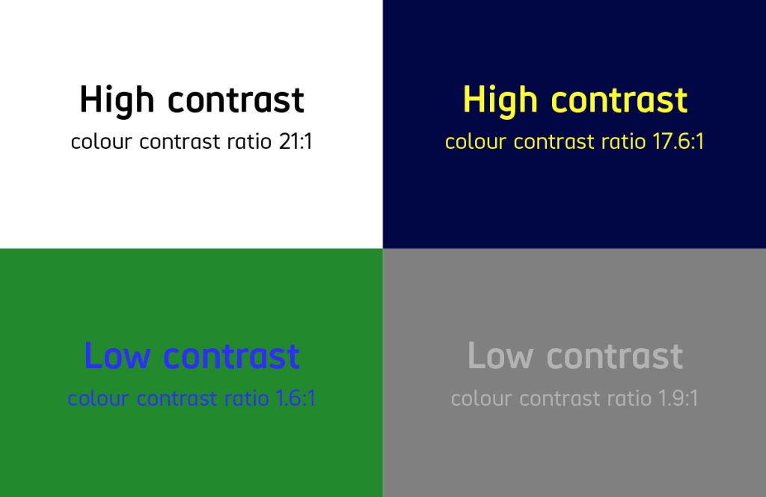
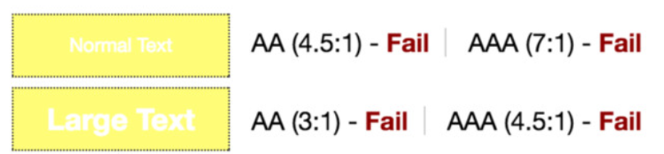
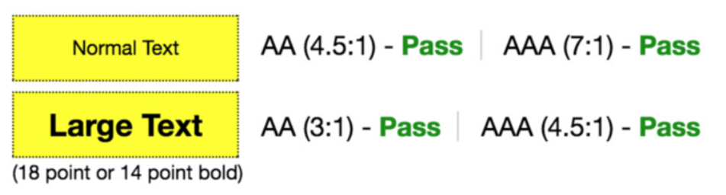

Slide 45
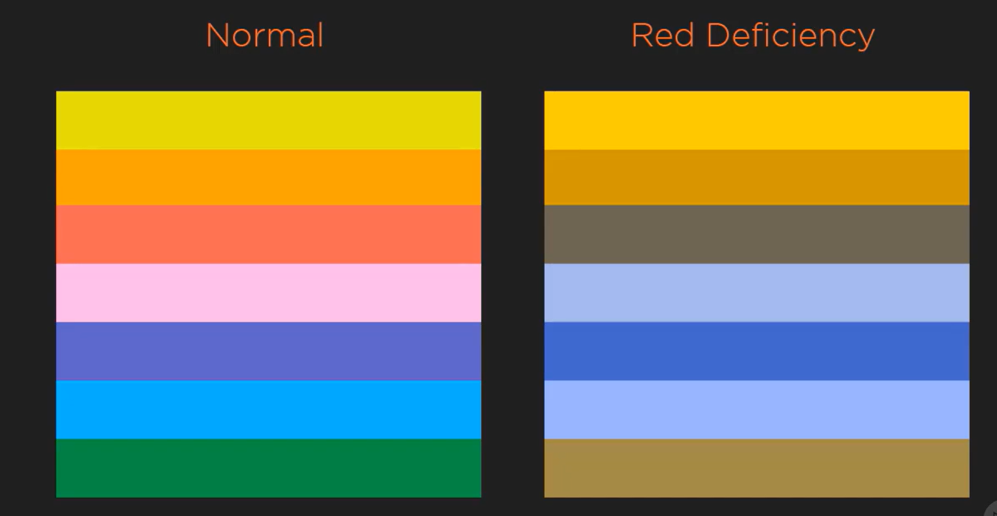
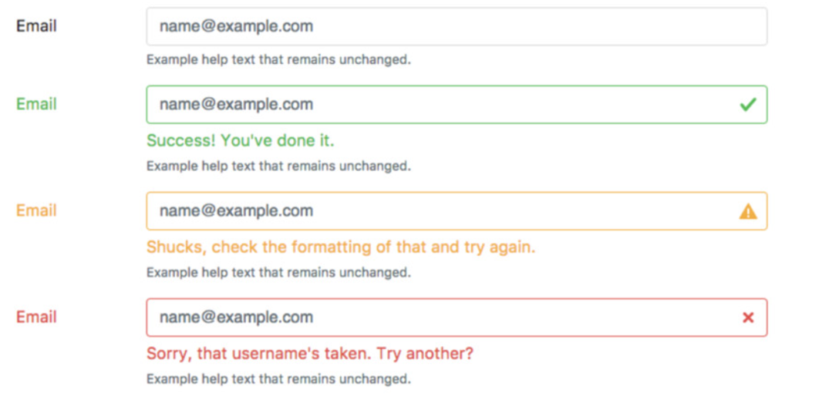
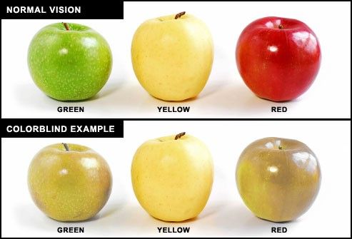
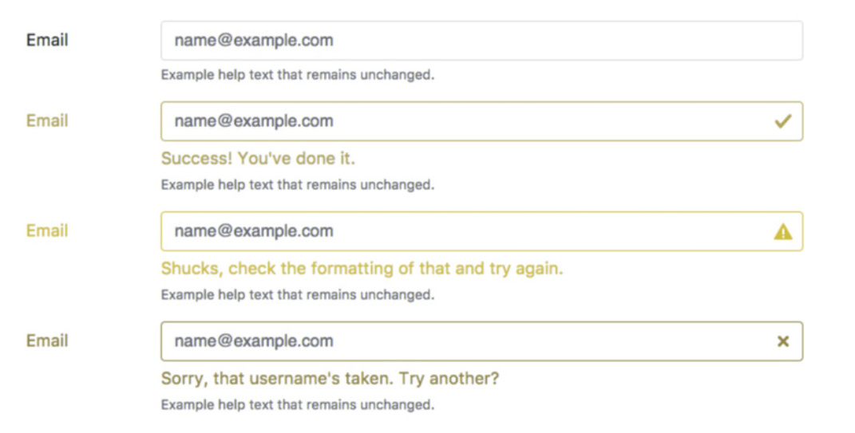

Slide 46
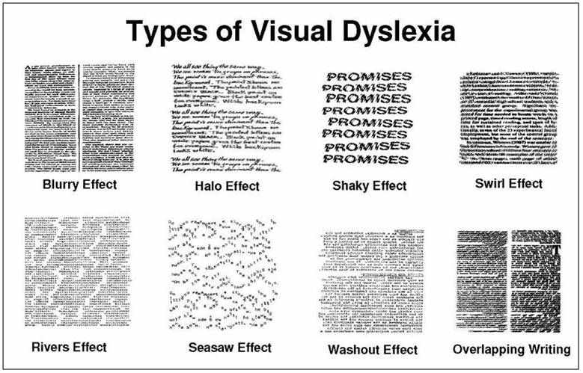
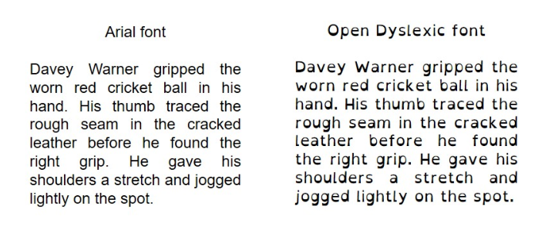

Slide 47
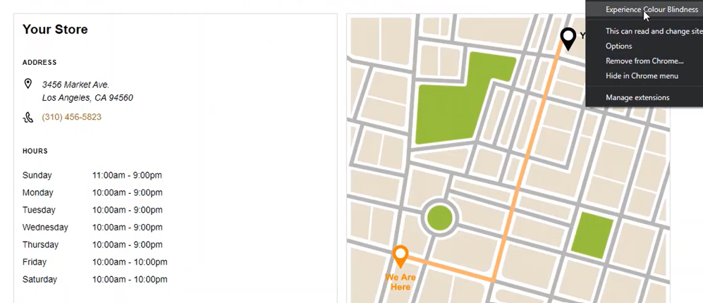
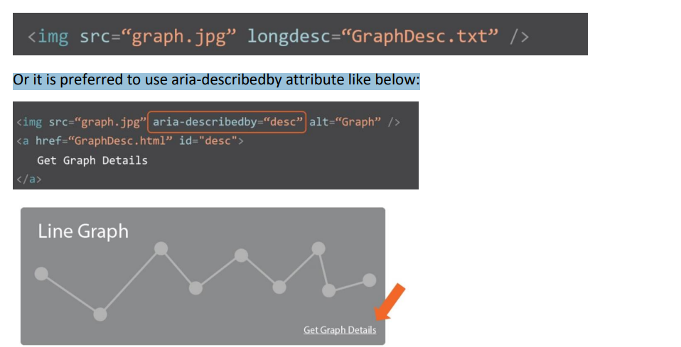
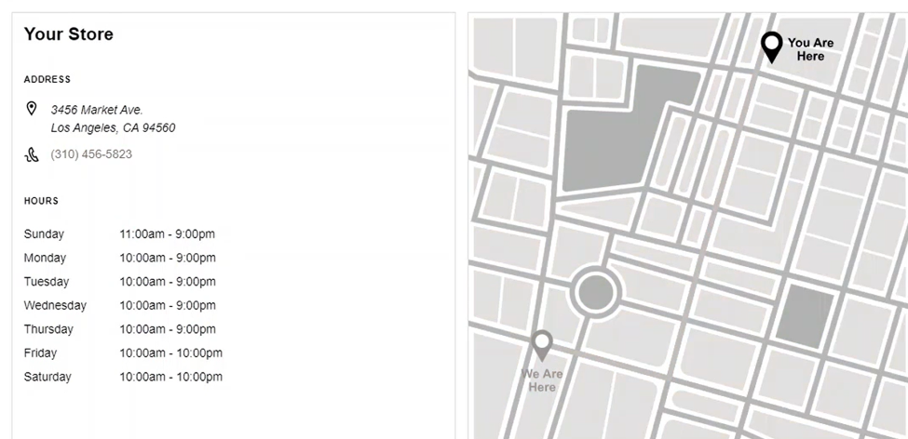
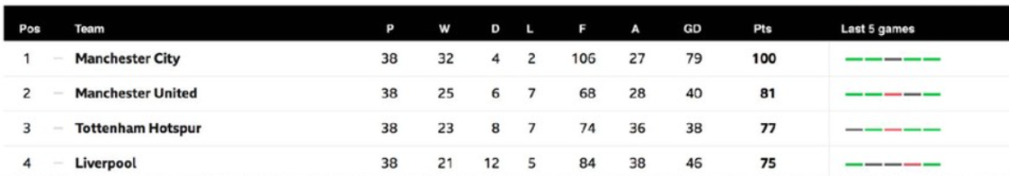
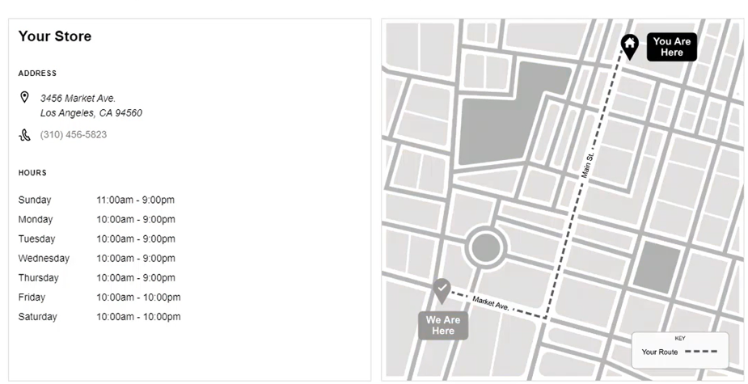
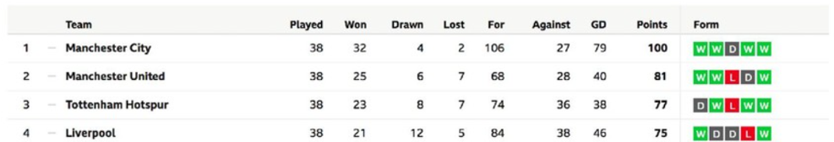

Slide 48
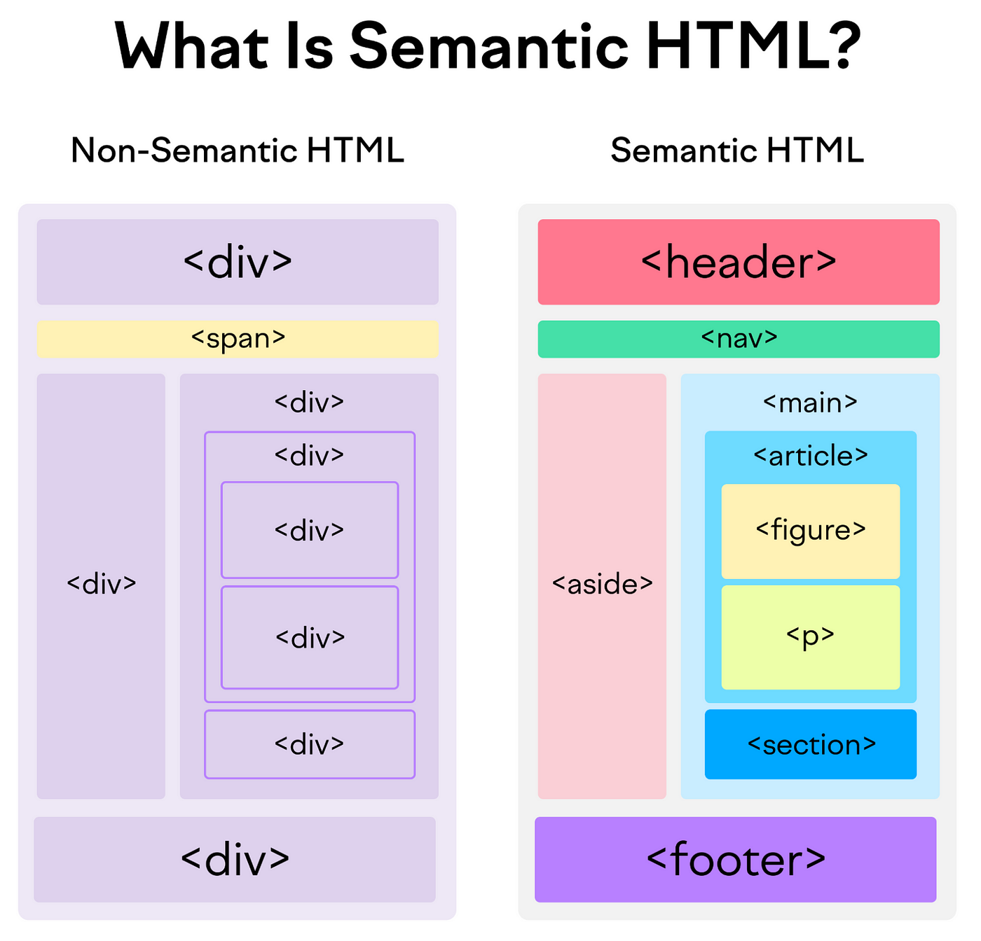
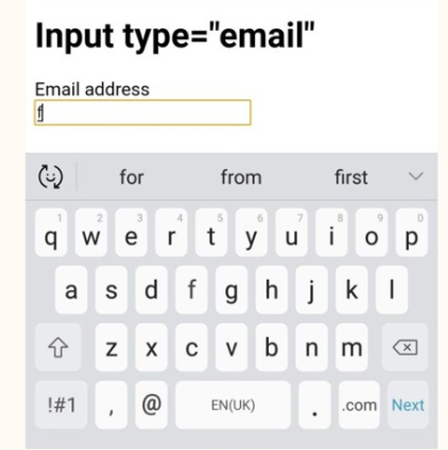
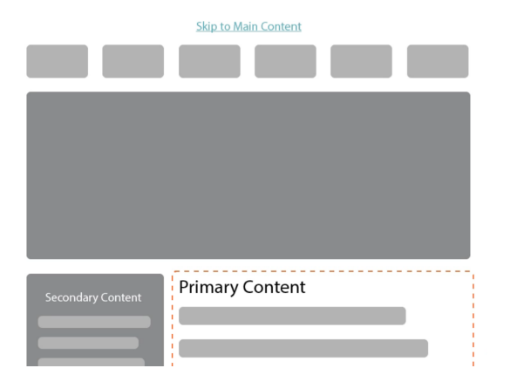
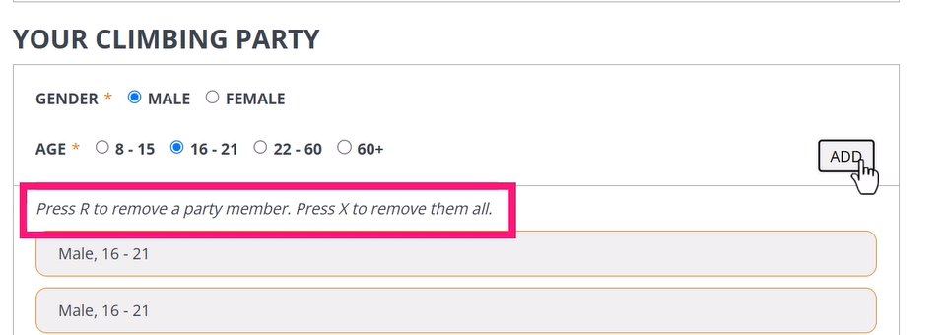

Slide 49
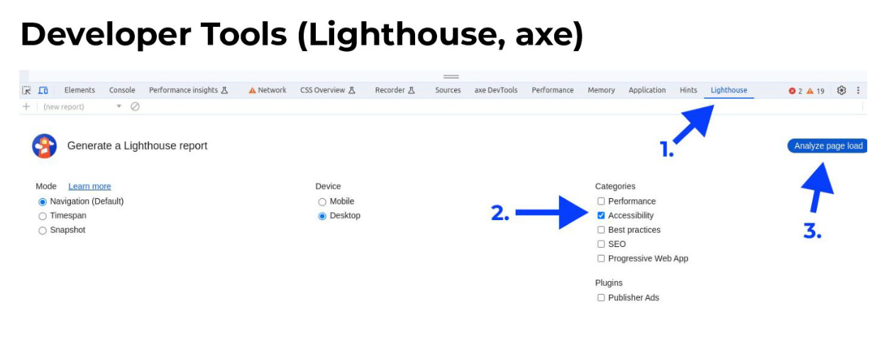
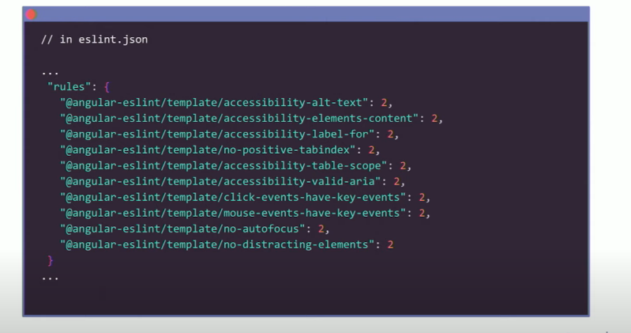
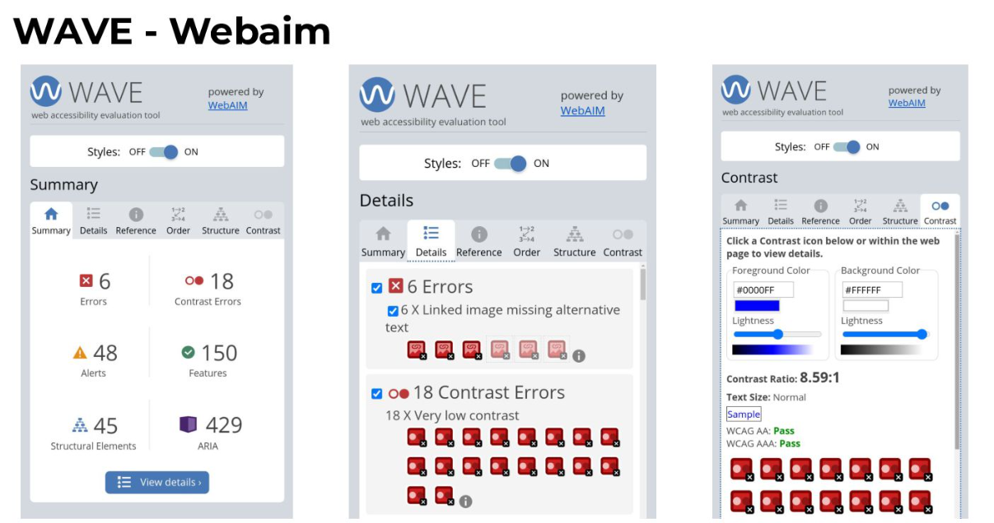
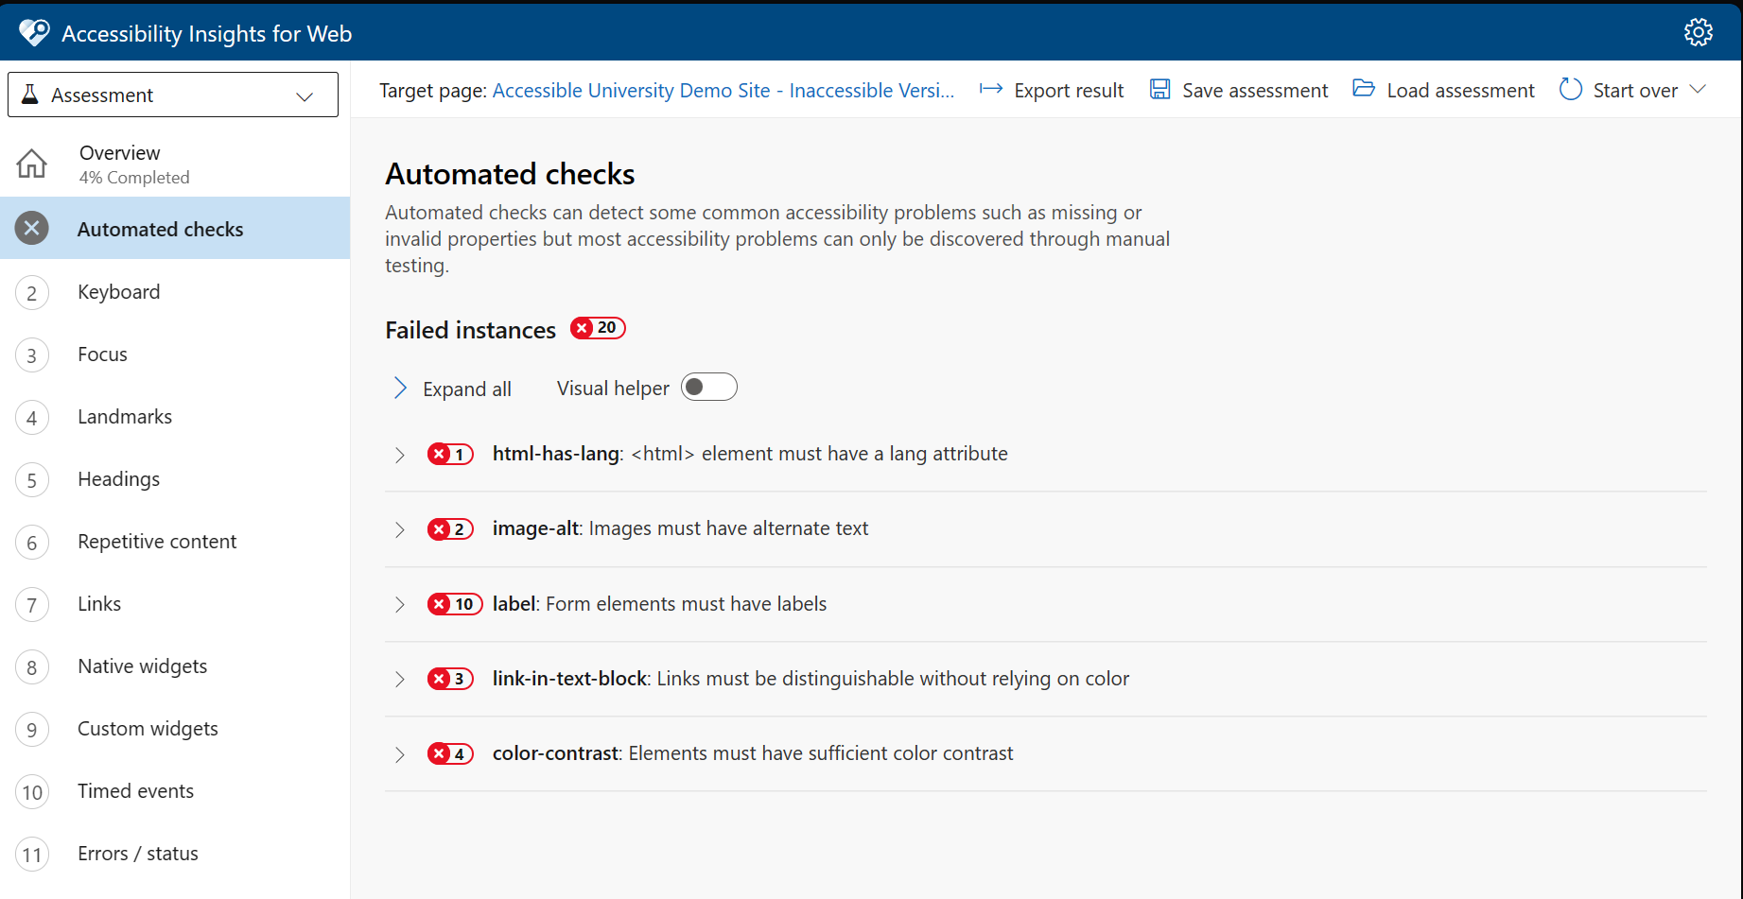

Slide 50
Quick Demo

Slide 51
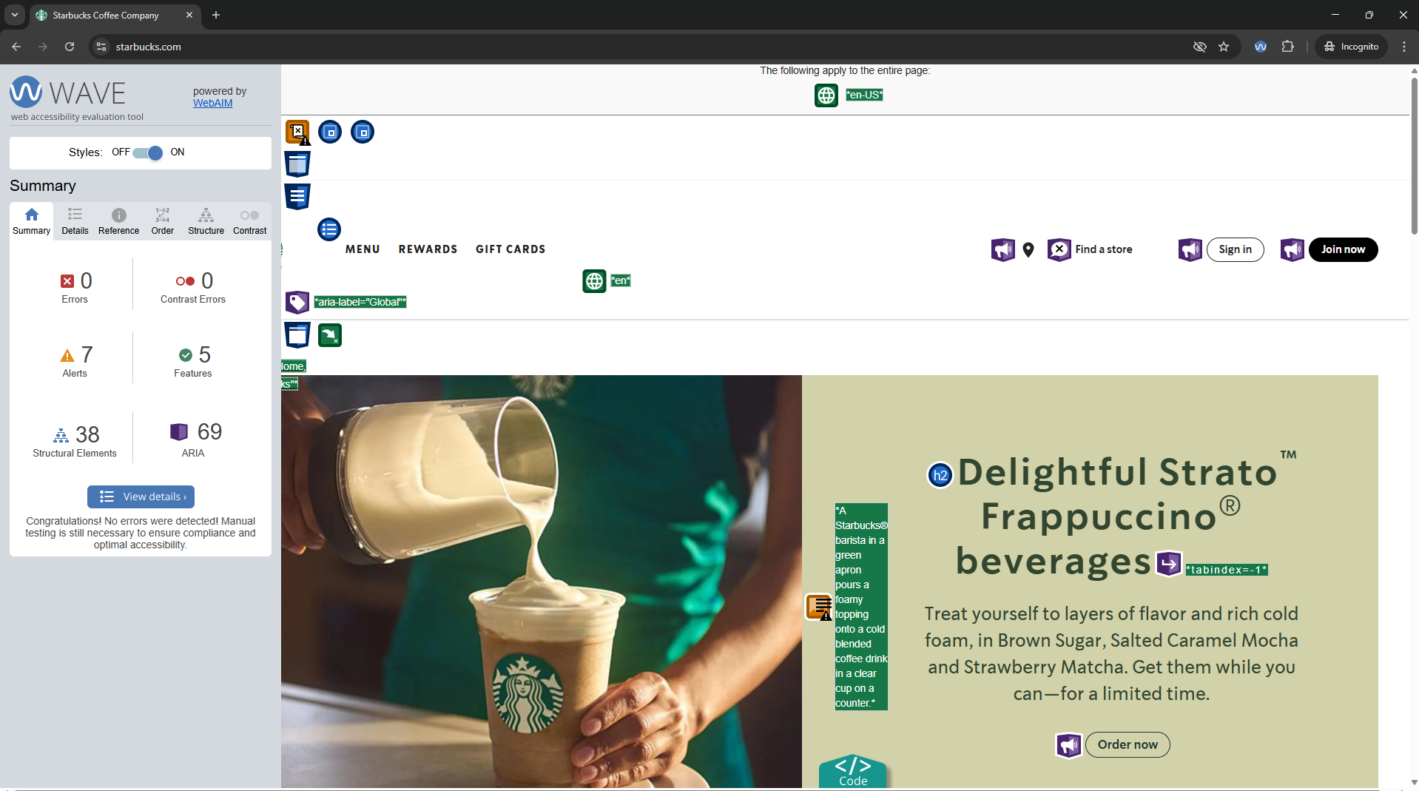

Slide 52
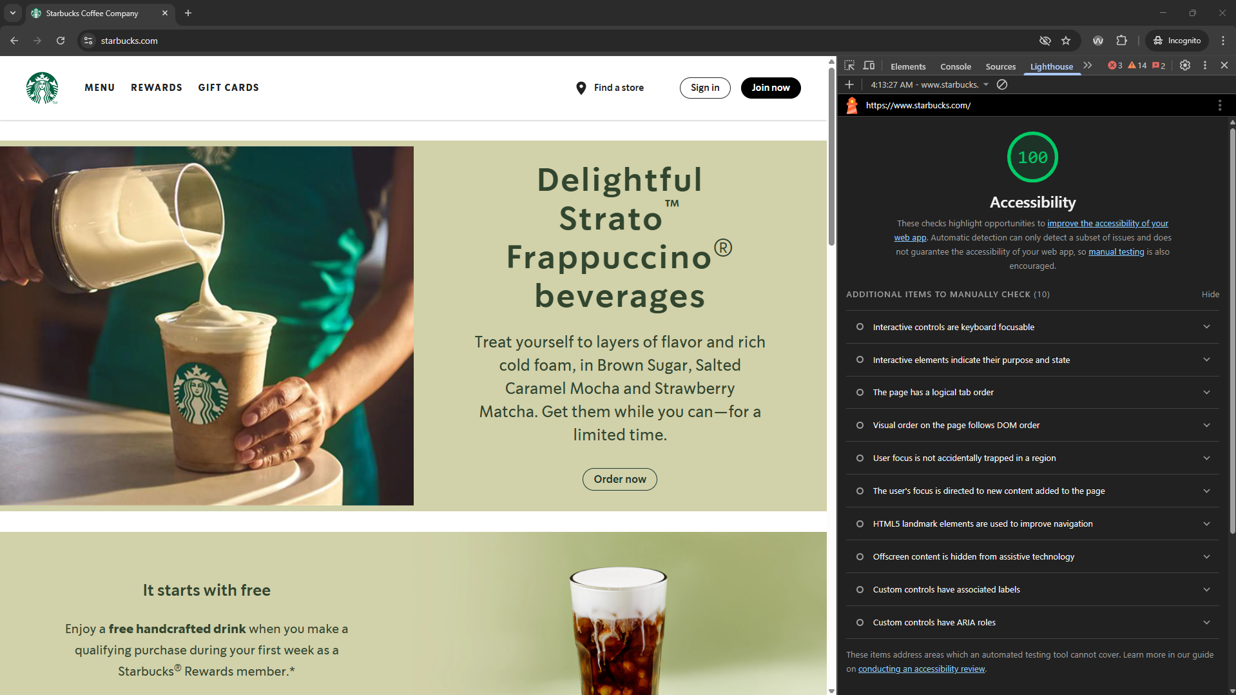

Slide 53
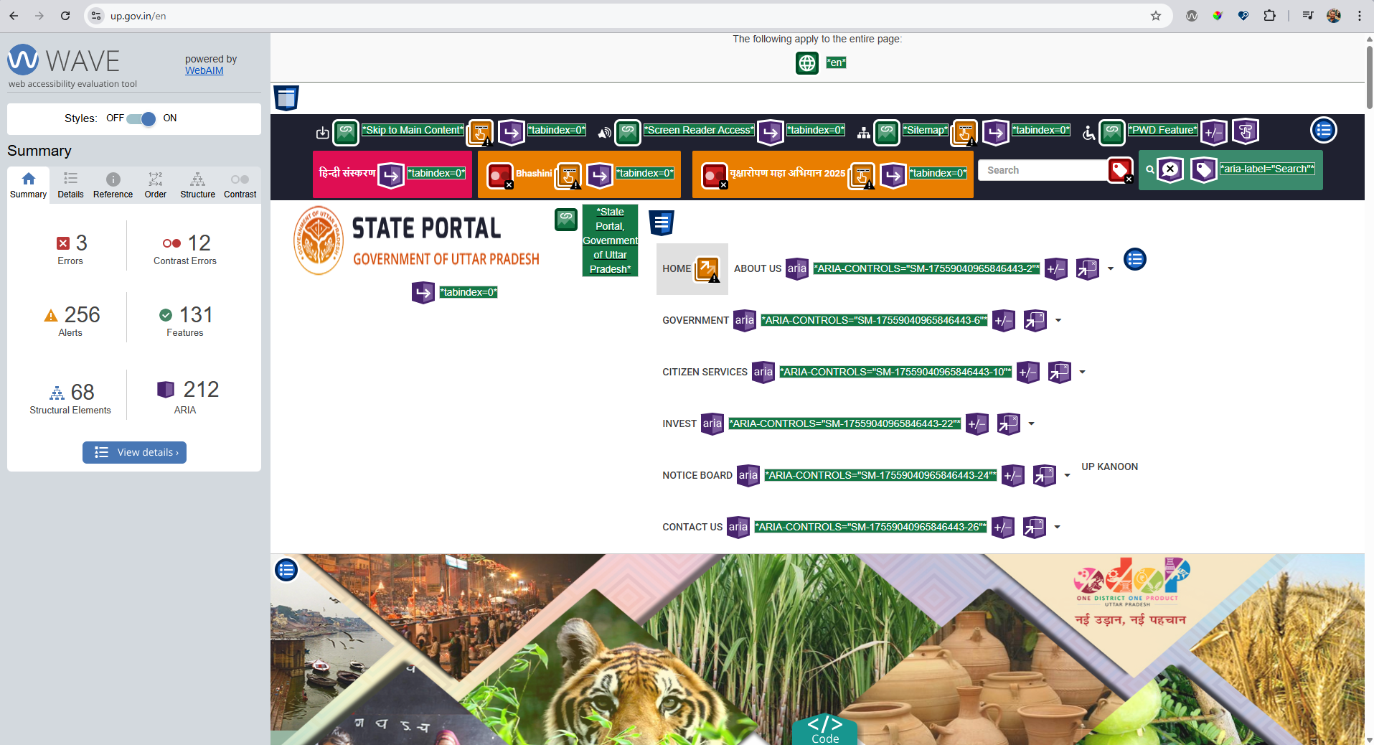

Slide 54
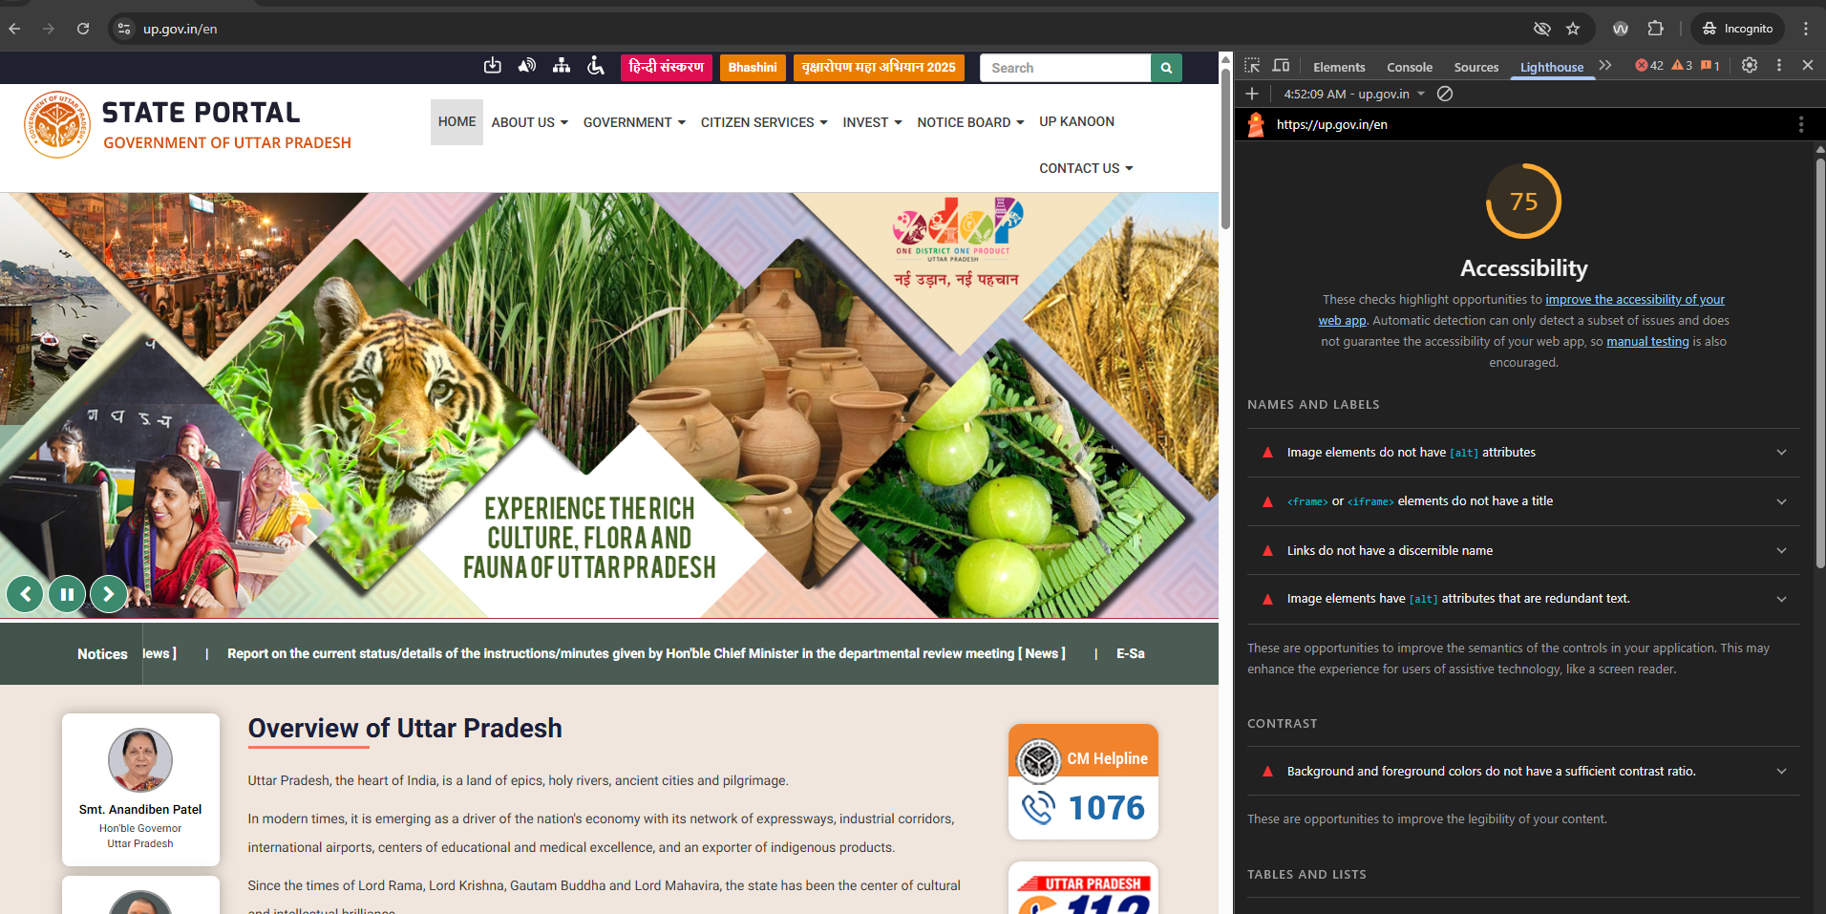

Slide 55
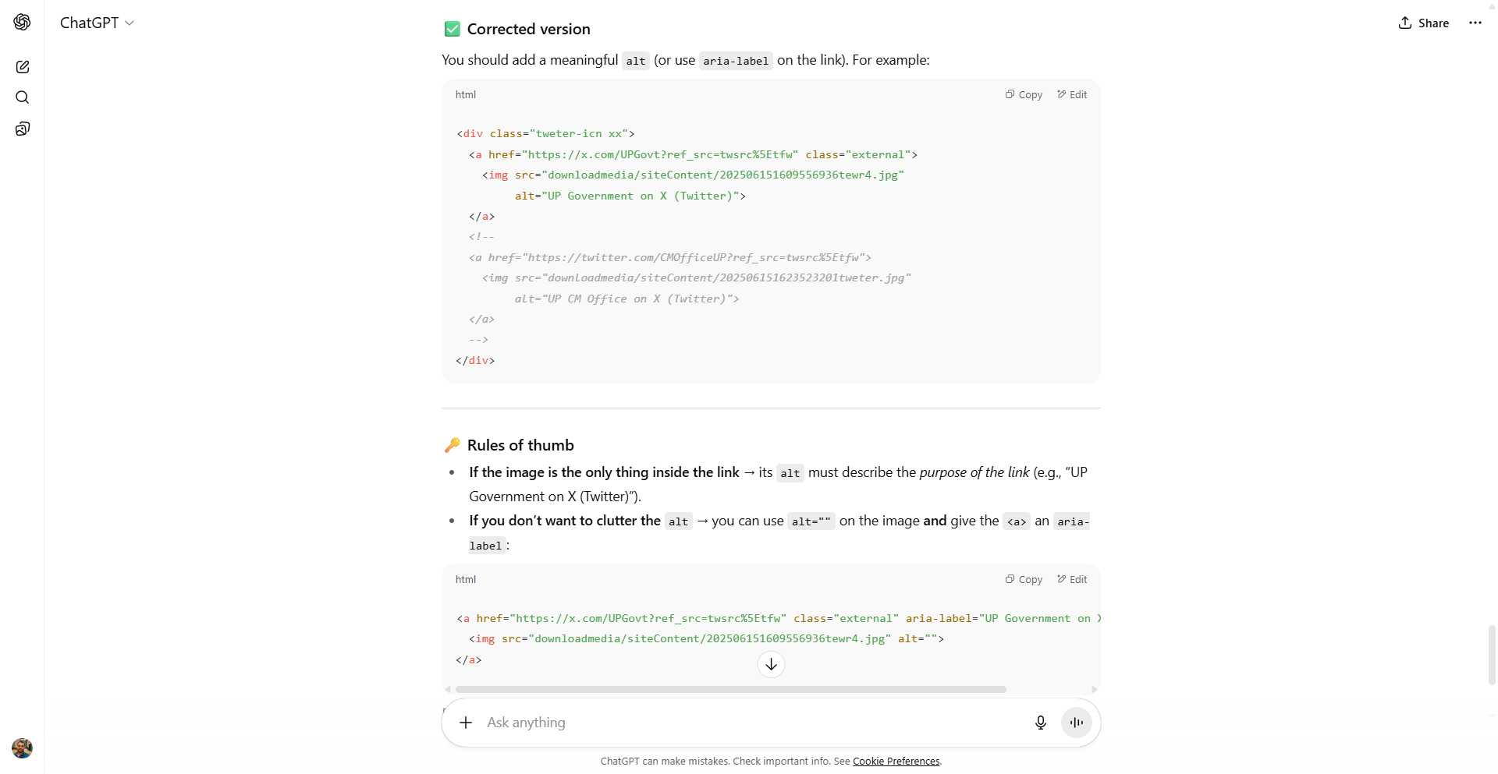

Slide 56
Tips and Resources

Slide 57
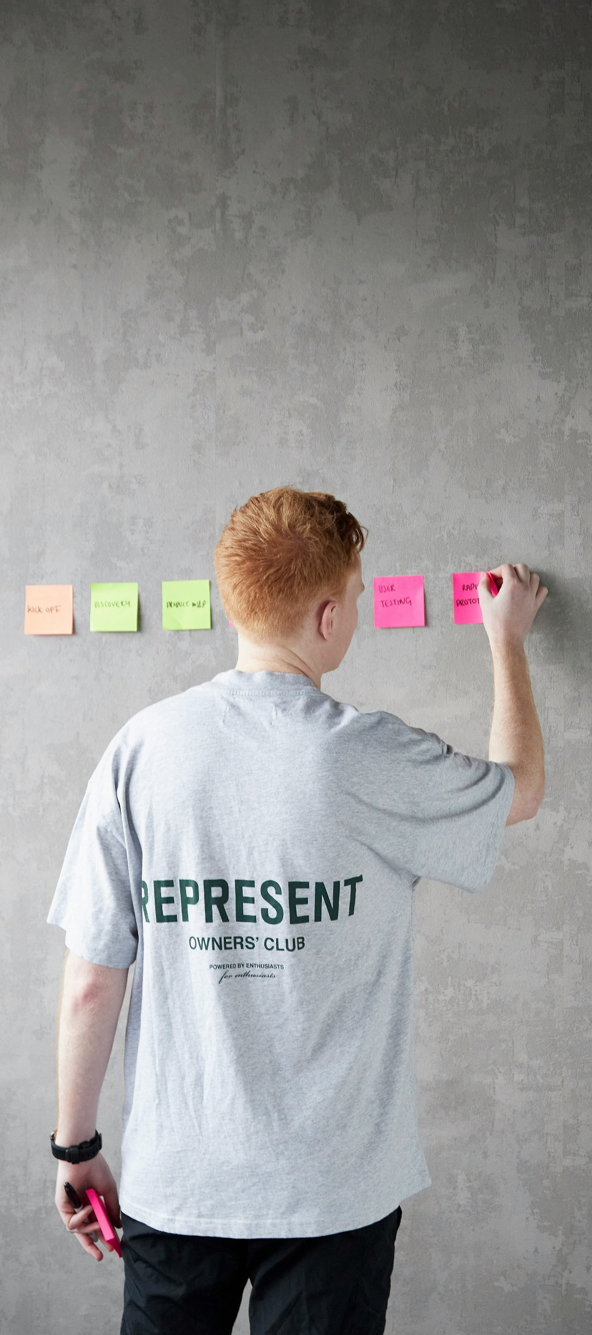
Tips That Help
Start Early
Design with Empathy
Think Keyboard First
Test with Real Users
Automate & Audit
Logs Bugs with a11y in Mind

Slide 58
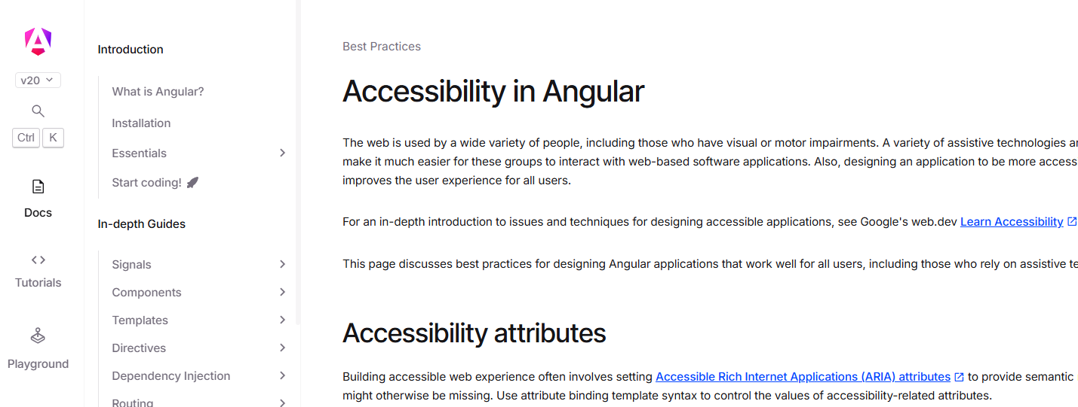
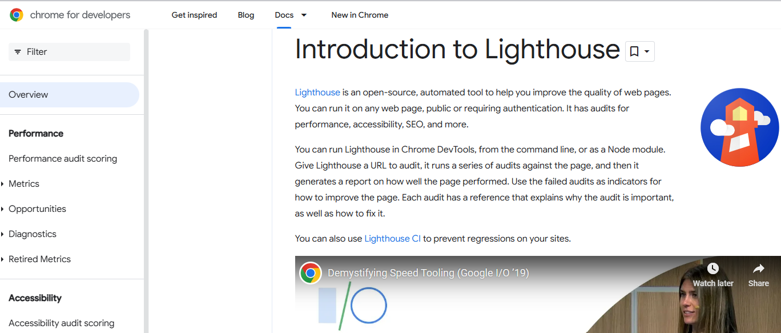
Learning Resources
The Accessibility Best Practices in Angular
https://angular.dev/best-practices/a11y
The Accessibility Best Practices in React
https://legacy.reactjs.org/docs/accessibility.html
Web Content Accessibility Guidelines (WCAG)
https://www.w3.org/WAI/standards-guidelines/wcag
Google Lighthouse
https://developer.chrome.com/docs/lighthouse/overview
The A11y Project
https://www.a11yproject.com
Microsoft Inclusive Design Toolkit
https://inclusive.microsoft.design

Slide 59
Let’s Test Our Awareness!

Slide 60


Slide 61
What challenge does the character face?
Dyslexia
A boy struggles with reading and writing.
Use readable fonts like OpenDyslexic or avoid overly decorative fonts.
Keep layout clean, with proper spacing and high contrast.
Use simple language and short paragraphs.
Avoid flashing animations or confusing navigation.
How can we make our apps more inclusive?

Slide 62


Slide 63
Deaf and Blind
A girl who cannot see or hear.
Story of how support and empathy can transform a life.
What challenge does the character face?
Provide multi-sensory feedback (haptic/tactile cues)
Ensure keyboard navigation and consistent layout for assistive devices
Add transcripts or captions for all media.
Use ALT text for all images.
Ensure buttons, links, and headings are clearly defined.
How can we make our app more inclusive?

Slide 64

Braille

Slide 65


Slide 66
Mild intellectual disability (low IQ).
Story about a simple man with big life experiences.
What challenge does the character face?
Use simple, plain language for content.
Provide audio or visual guidance instead of text-heavy instructions.
Design with clear navigation and large, easy-to-click elements.
Support text-to-speech features.
Avoid time-based actions or complex user flows.
How can we make our apps more inclusive?

Slide 67

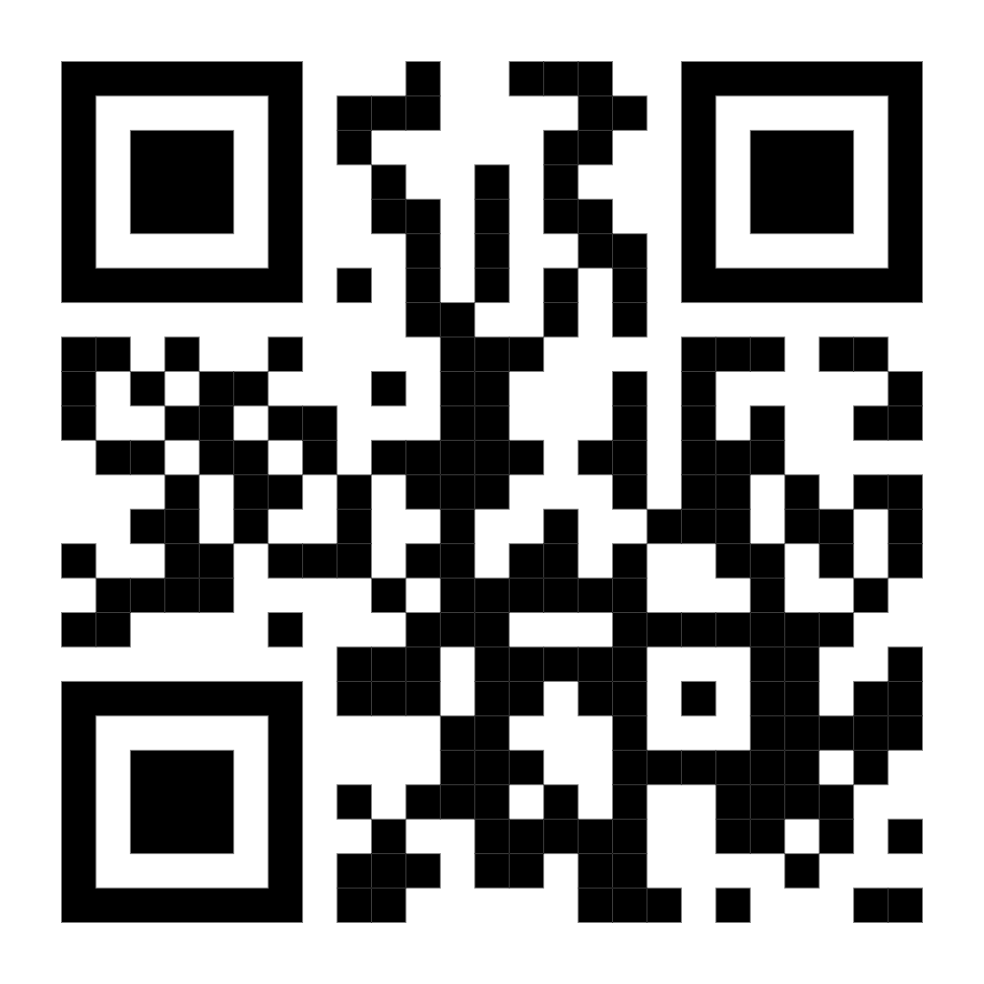

🙏
Thank You!
Everyone Here
&
Himanshu Goel

